Slide 1

Planning Media Strategy
& Punching above your weight
Rob Dyson, PR Manager & social media

Slide 2
What’s in a strategy?
Your story's assets are the same, but the language changes for each audience.
The fundamentals are really just about telling that story, and being human.
Sometimes, the story may get ‘translated’ (or re-told), so ensure your core messages are strong and clear.

Slide 3
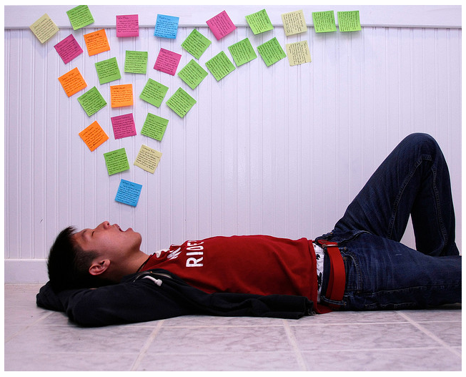
Not about broadcasting…

Slide 4
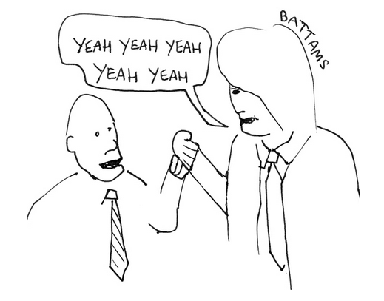
But relationships

Slide 5

Four ‘R’s of media strategy
Research
Read
Re-adjust
Remember

Slide 6
Research. Who writes about your interest area? Who reads about it, and who are you trying to influence? Which names keep coming up? Make a list – keep it up-to-date.
Read. Become familiar with the language and tone of this conversation and those in it. A lot of newspapers, magazines and some journals have free web content; search for phrases and journalists and access their articles. From here you can:
Re-adjust your message to resonate with the mood. Parroting language is used by good communicators. Couching your story in the terms and tone of others can suddenly bring it into sharper focus for your audience. So re-tune versions for broadsheet and trade, tabloid and local, bloggers and tweeters.
Remember all the people that are important (not necessarily big name journalists or politicians). These are your allies, and they can also introduce you to others. You know who the influential people are in your life, so do the same in terms of your charity or area of work.

Slide 7
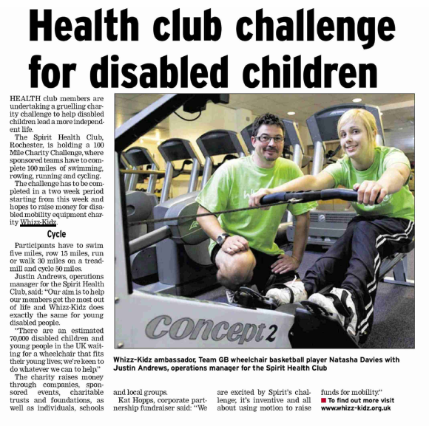
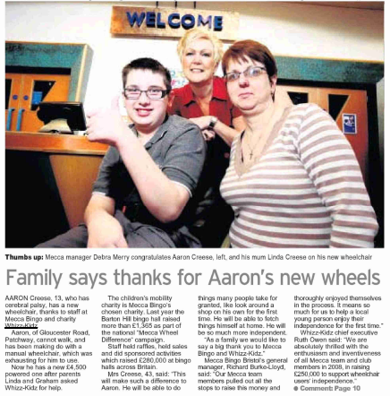
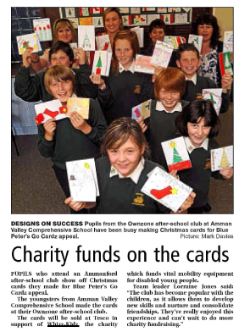
If it’s a local issue – make it local
Real people
Real stories
Relevance to local people

Slide 8
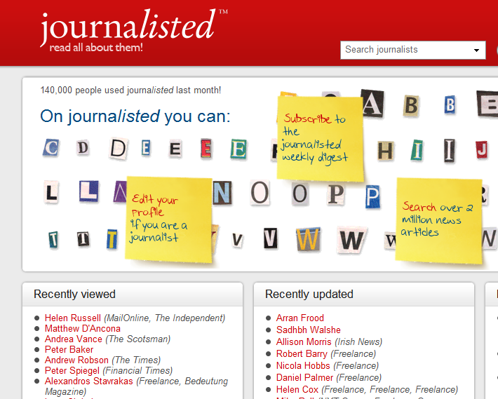

You don’t set the agenda – but you can shape it
Top tip – contacts in these free places

Slide 9





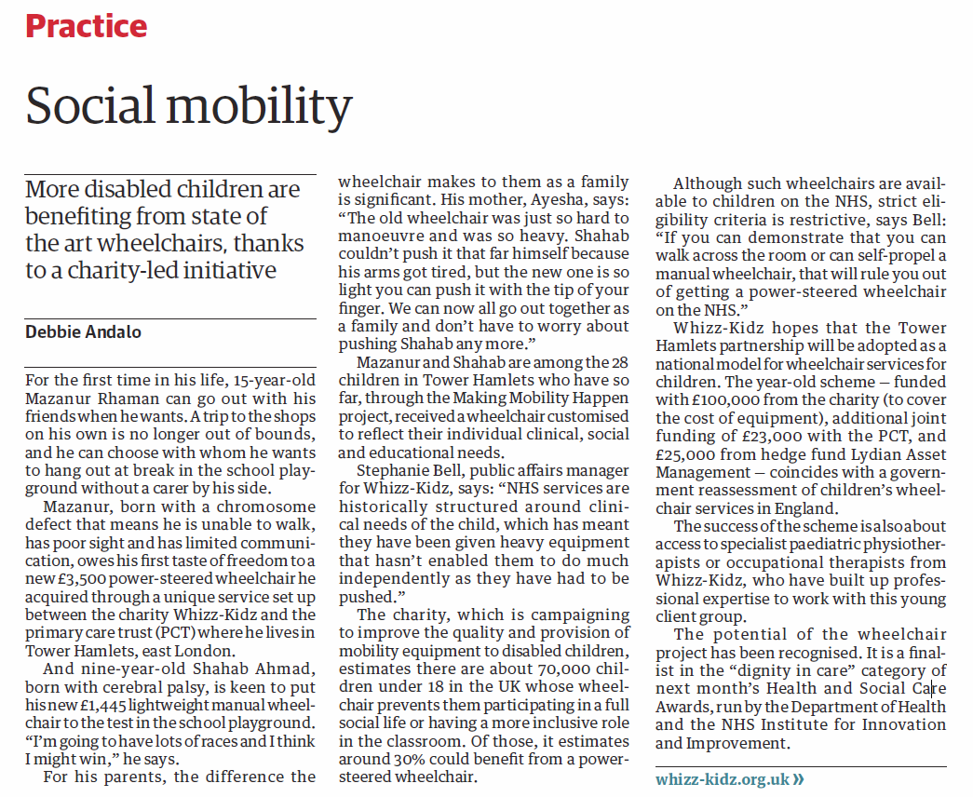
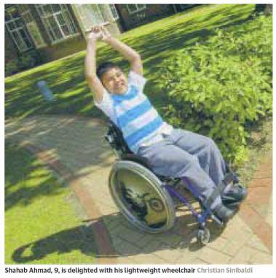
Case study: the pitch
+ =>
<=

Slide 10


Case study: catch a wave
A conversation with a PR friend at another non-profit about a charity-wide survey they were pitching. Meanwhile I was looking for an angle for a Frontier Economics report & our NHS partnership work.
Led to me pitching in my charity as a case study illustrating their story.
Inspired journalist to feature us both in a topical piece on The Big Society & what it means to charities (double hit with Blue Peter)

Slide 11
Join networks, make friends
EMF – event management forum
Institute of Fundraising
third sector PR & communications network (Facebook & twitter)
CharityComms
Network at seminars, conferences & ‘tweetups’

Slide 12
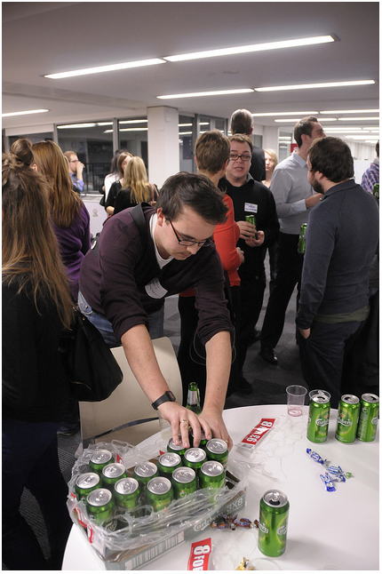
Sometimes there’s beer

Slide 13
Integrate channels
You’ve got your story (e.g. new survey or evidence or report) + case studies + approach targets.
Now use the social web to make it viral, and relevant to Joe Public.

Slide 14

Listen to the chatter.
Search Samepoint.com for mentions of your org (including misspellings) and key areas of work in social media and online blogs

Slide 15

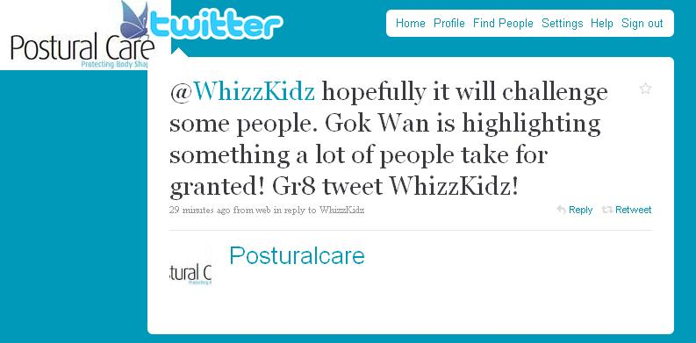
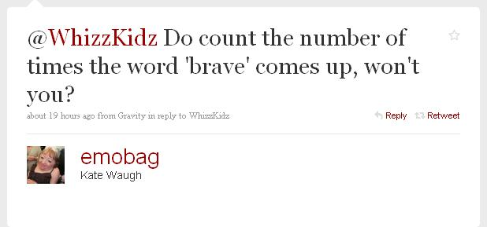
Build an appetite through conversation

Slide 16
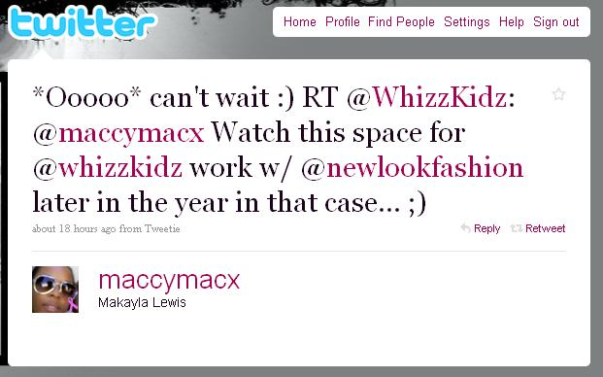

…and use to introduce your work

Slide 17
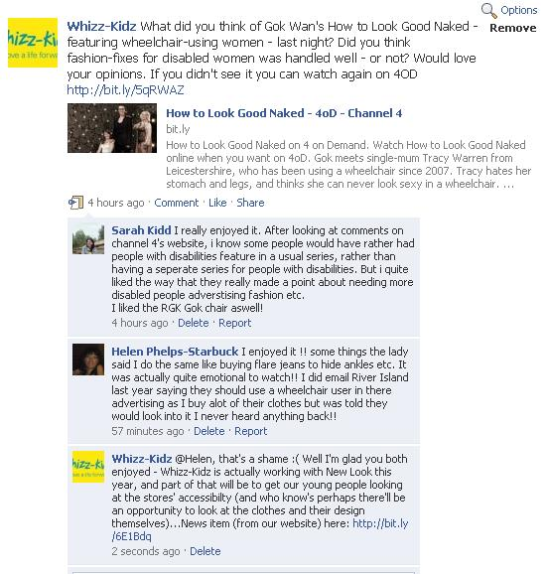

Spread conversations across networks -

Slide 18
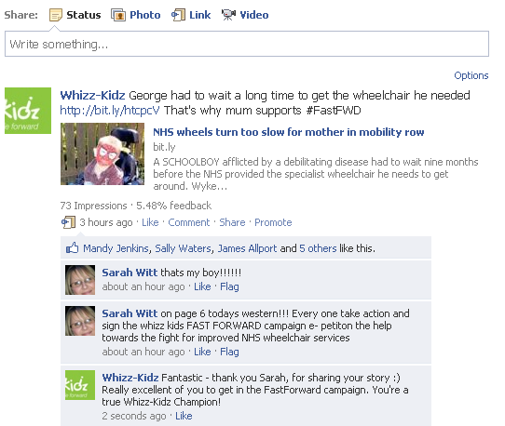

Facebook is a key tool for sharing messages & building momentum

Slide 19
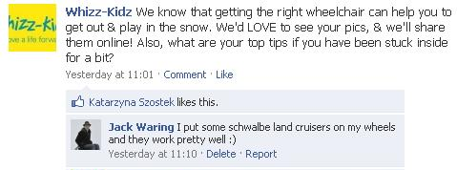

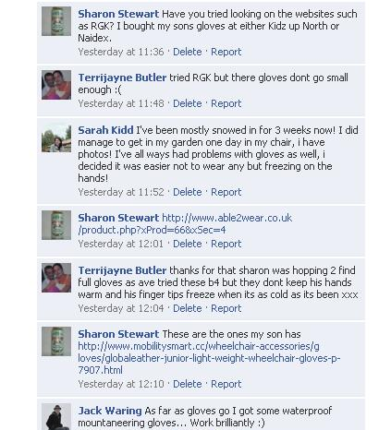

opening a space for peer to peer advice & debate

Slide 20




Ask a simple question, get a simple answer…

Slide 21
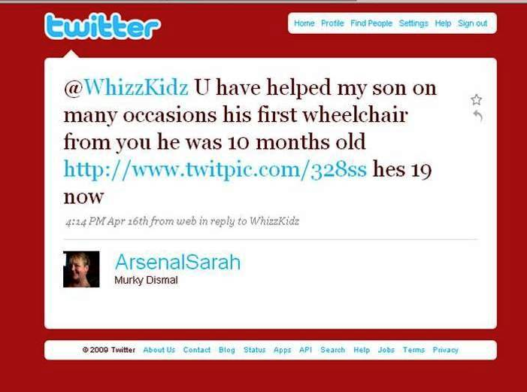

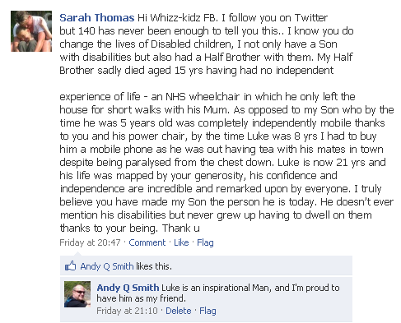
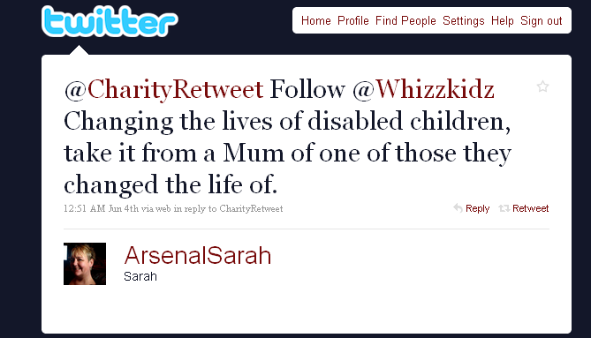
Bringing people with us, staying ‘local’ to loyal champions

Slide 22

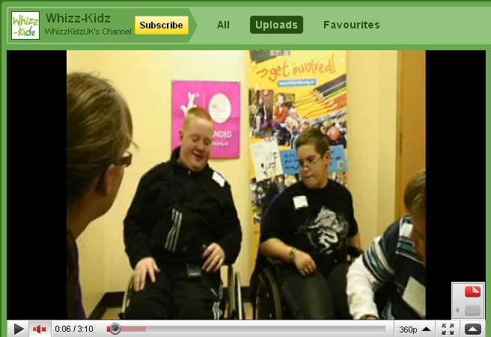





The viral loop: cross-promoting all of our sites

Slide 23

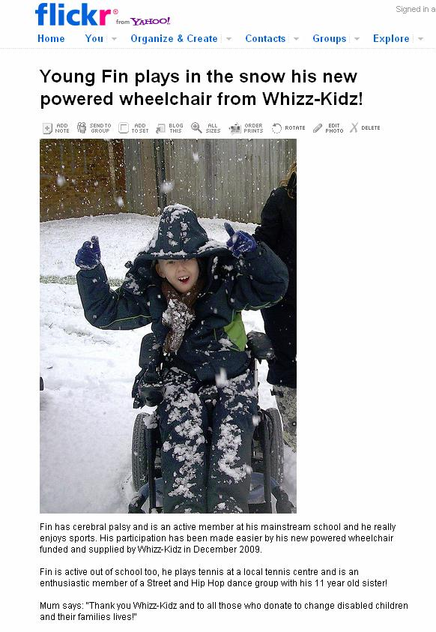
Sharing stories directly on Flickr
Fin’s mum:
“If sharing Fin's story helps raise money and awareness then it is our way of saying thank you…
“And it makes Fin feel special and like a celebrity! He loved seeing his photo on flickr!”

Slide 24

Polling opinion of our followers…
“to be truthful its very imaginative!
good thinking by the whizz-kidz team
*APPLAUSE*”
twitter.com/jamandcheese
“Nice one. Will certainly get
the attention of your target audience!”
twitter.com/rachelbeer
“Great poster
Could you do one for the ladies?”
Childsi, Child's i Foundation
234 views on Flickr - within 3 days spread via Twitter

Slide 25
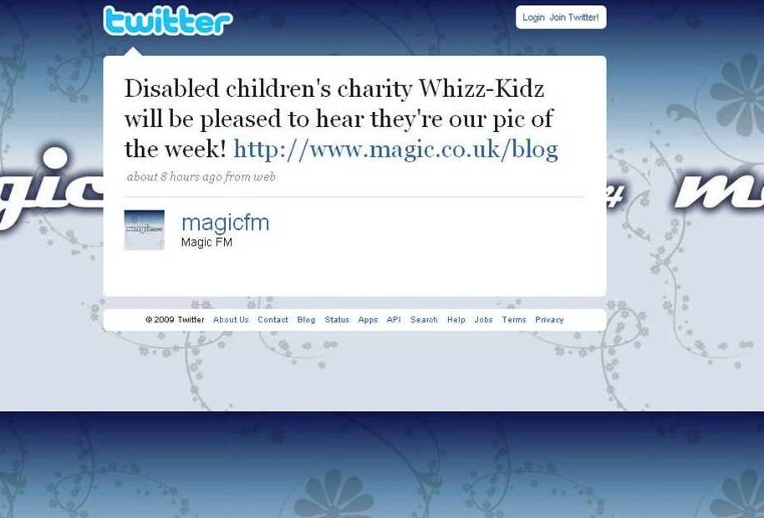
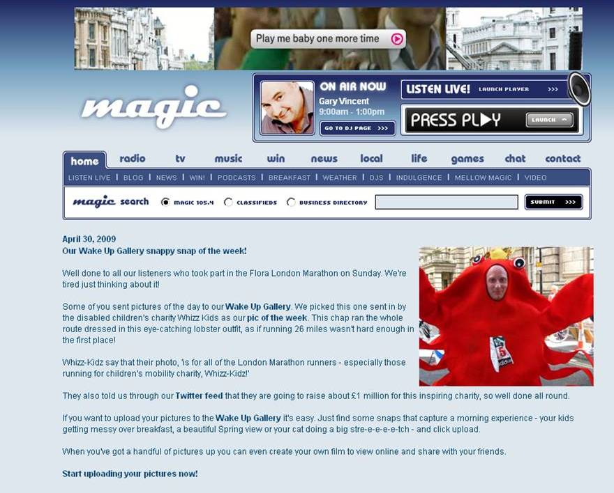
Magic FM helped us out during Marathon because we “tweeted” them…

Slide 26
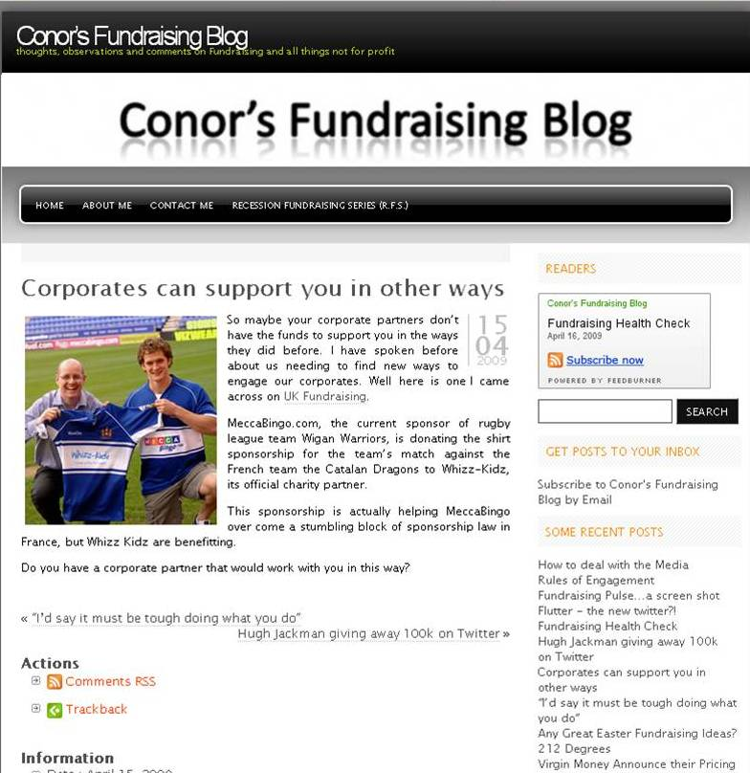
Influencing the influencers
Tweeting
Stories that
capture
imagination

Slide 27

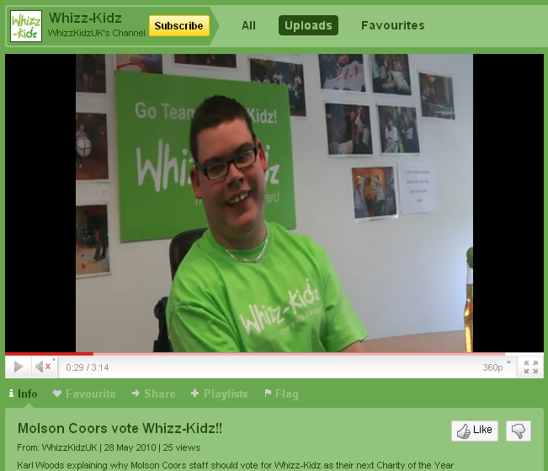
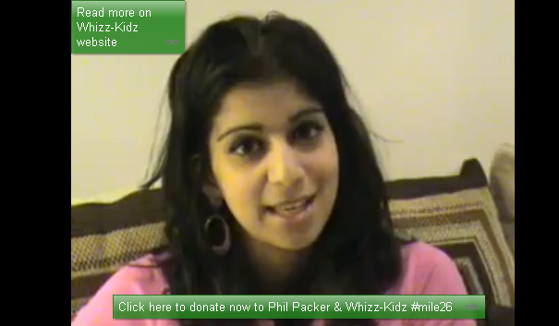
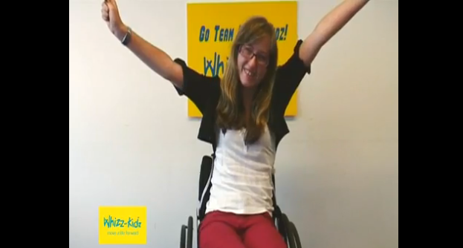
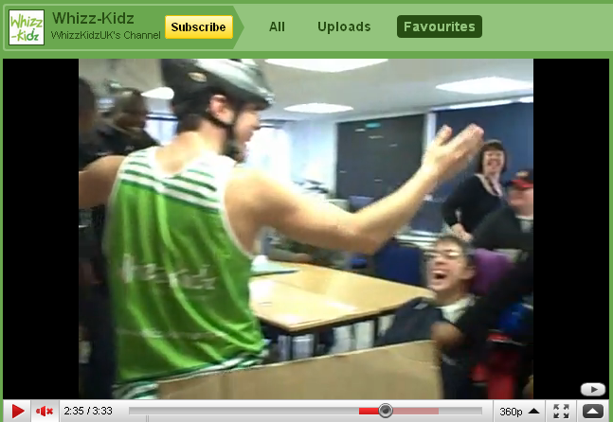
We use to record video messages from our
young people – to encourage top fundraisers to double their target, and to supplement Charity of the Year Corporate pitches
Team Whizz-Kidz runners in
the London Marathon
made their own creative videos
to help fundraise!

Slide 28
netiquette
In social media, Whizz-Kidz:
We don’t:
answers questions
asks questions.
invites people to attend events and join campaigns.
are helpful and signpost to different parts of the org, and website.
talk like real people.
Has fun & tries to be creative.
delete messages we don’t like.
just link to press releases.
criticise or dismiss anyone
leave our profiles stagnant.
limit chances to take part.

Slide 29

Metrics – what’s important to you?
Numbers?
- mentions, followers, fans
Conversations?
Retweets / referrals?

Slide 30
Summary
Conversation is king: it’s still all about relationships – online & off.
Be flexible about your story – use journalists to focus new angles to ‘catch a wave’.
Find your ambassadors & champions online.

Slide 31
Thanks for listening
Robdysonpr.wordpress.com
@RobmDyson @thirdsectorPR @whizzkidz
Photo credits
Strategy http://www.flickr.com/photos/8998965@N05/560679422/
Not listening http://www.flickr.com/photos/tigronx254/3502102037/
Relationships http://www.danielbattams.com/
R is for http://www.sproutonline.com/ Sesame Street
Coffee http://www.flickr.com/photos/zerlinaa/3045153131/
Telephone http://www.flickr.com/photos/7892616@N06/2556177237/
Sometimes there’s beer http://www.flickr.com/photos/hellobeautifulworld/
Measuring tape http://www.flickr.com/photos/lianakabel

