Slide 1
Meaningful and manageable evaluation
Susie Rabin
Campaigning Effectiveness, NCVO
Hugh Mouser, Global Witness

Slide 2
Why monitor and evaluate?
Strengthen the impact your campaign can make
Empower people and communities
Learn from what you have done
Notes:
If you’re a campaigner, the chances are that you want to change the world and make it a better place. Assessing whether your campaign is making an impact – monitoring and evaluation – can help you do a better job of it. There is no one approach – what you do depends on what you want to know and why, your resources and expertise.
In all cases, monitoring and evaluation can:
Strengthen the impact your campaign can make
Empower people and communities
Promote wider learning

Slide 3
M&E can be a valuable part of your campaign
In development and planning stages
During campaign delivery /implementation
At the end of the campaign
Notes:
M&E can be a valuable part of your campaign:
In development and planning stages to check that assumptions on which the campaign is built are sound and take into account the challenges you are facing
During campaign delivery /implementation to measure progress against expectations and allow you to adjust your approach accordingly
At the end of the campaign to draw out the learning for future work

Slide 4
Some principles of M&E
Build evidence, not proof
“if it quacks and has feathers, it’s probably a duck”
Outcomes are more important that outputs
Measure the important things, not the easy things
Keep it simple and user-friendly
Notes:
M&E is not always a straightforward or simple undertaking - change is complex. Trying to prove causal links between campaign activities and certain social transformations ignores this complexity.
However, by adhering to some key principles, M&E should be a manageable and positive process for all involved:
Instead of looking for proof, look to build evidence that could reasonably be used to assert a connection between your activities and subsequent social and policy change i.e. “if it quacks and has feathers, it’s probably a duck” (Good Campaigns Guide, NCVO, 2005)
Outcomes are more important that outputs – it is important to measure the effects and not the effort i.e. activities when assessing impact. Be clear about when you’re assessing effectiveness or efficiency.
Measure the important things, not the easy things – it is understandable that outputs (the number of events, letters) are easier to measure than outcomes (what happens because of this activity). These are more easily in the control of the campaign but can have a negative impact if focus on achieving change is distorted.
Keep it simple and user-friendly – develop a small number of indicators to substantively capture changes in the situation. A system for monitoring these changes needs to be built into the campaign plan.

Slide 5
Some principles of M&E
Some information is better than none
“It’s not the purity of the process that’s important, it’s the quality of the thinking”
Establish the link to action
Create a learning culture
Notes:
The most sensible starting point is that some information is better than none at all. Taking steps towards enhancing learning and accountability is better than saying it’s too difficult so there’s no point in trying. “It’s not the purity of the process that’s important, it’s the quality of the thinking” (Is your campaign making a difference? NCVO, 2008)
Establish the link to action – whilst m&e can negatively be seen as mechanism of control (e.g. as a means to satisfy the requirements of donors or senior managers) which has it’s place in some circumstances, in our view it is an important part of organisational learning and thus should be one of the overarching goals. This is why it is important to make use of information collected whilst the campaign is running, and not just information gathered at the end. This requires a light, simple, flexible approach to collecting information, forming part of a cycle of action – reflection - action.
Effective m&e requires internal leadership, clarity over roles and responsibilities, and a learning culture that promotes critical thinking and recognises information about both success and failure as valuable information. Someone must be responsible for not only collecting information, but to make time in the daily life of the campaign for reflection. These can sometimes be merged into existing processes, e.g. monthly supervisions between staff and managers, or team meetings and planning meetings with staff and partners.

Slide 6
Creating an impact
Activities: Consumer research to identify clearest labelling, Lobby government departments, email actions directed at companies
Outputs:
Outcomes: Government issues clear guidelines on food labelling, major companies adopt clear food labelling
Impact: People’s health improved by having access to clear information about food
Notes:
Campaigners seek to make the world a better place through challenging the status quo and taking on vested interests in order to secure social and political change that improves people’s lives. In it’s simplest terms, the process could look like this:
The campaign – social and political efforts and changes secured – improvements in people’s lives
The same process can be represented in the following terms:
Activities/ outputs – outcomes – impact.
Whatever terms are used, the basic idea is the same: campaigning is a purposeful activity with an underlying logic: that well-organised activities will contribute to impact. Of course, change does not happen in a linear fashion, but the exponential power of this simple formula lies at the heart of campaigning as a force for wonderful and startling change.

Slide 7
Summary of key steps
Identify the purpose of m&e
Decide who should be involved
Deciding your focus
Deciding what information you want to monitor
Deciding how you will collect the information you need
Notes:
Identifying and being clear about the purpose if m&e, this could
Improve decision making and impact
Promote learning
Ensure accountability to stakeholders
Influence targets
Motivate campaigners
You should identify what you want to know, and why you want to know it, before you start to think about how you want to do it.
Identifying purpose should help you to identify who should be involved/consulted, but you may need to keep coming back to this. We strongly recommend that you involve beneficiary groups at key stages, because a campaign cannot be judged to be a success or failure if the criteria, perceptions and judgement of those the campaign is aiming to benefit are not taken into account.
Focus is key – keeping the m&e manageable but potentially exploring not only campaign outcomes and impact, but also ways of working.
What you want to know will be determined by your purpose and focus
Generally, you should be looking to gather evidence from a range of internal and external sources, using a mix of different techniques.

Slide 8
Developing an M&E framework
Set clear change objectives
  What steps should you take to achieve your overall aim?
Identify capacity and resources
  Be realistic about what you can achieve
Identify indicators
  What information will show whether or not objectives are being met?
Verification
  What sources will you explore and what techniques will you use to gather the evidence?
Notes:
Set clear change objectives – having a clear campaign design and plan is a fundamental part of assessing impact. Key to this is having clear, well thought out campaign goals, objectives and activities. Without this it will be difficult to assess progress and achievements, to measure against the steps that should be taken to achieve the overall goal or aim, and to understand what is and isn’t working well. These objectives should be based on a plausible hypothesis of how you think change will occur.
Identifying capacity and resources and building m&e into campaign planning can ensure that the m&e systems deigned are realistic and achievable i.e. in terms of time committed to recording monitoring information.
Identify indicators and build a critical mass of evidence – both qualitative and quantitative. It is unlikely that any one indicator or one view will be sufficient to demonstrate the effects of a particular campaign. Taken together, a range of evidence can offer more than the sum of its parts.
It is helpful to map out the sources you will go to and the techniques that could be used to collect the information. In doing so it would be helpful to explore a mix of information and sources to ‘triangualte’ i.e. use multiple sources, quant and qual, and anecdotal information.
CASE EXEMPLAR: The Disability Rights Commission tracked and shared information on campaign progress through a forum they set up with campaigners in disability and health related organisations. When the DRC launched their DOJO transport campaign, for example, they discussed their ideas with the Forum and what they wanted to achieve. Through discussing their approach with other organisations – specifically responding to detailed questions about how they were planning to engage with young people – they realised they needed to go back to the drawing board on some aspects of the campaign to make sure they weren’t missing anything out.

Slide 9
The simplest approach
Creating space for reflection
  At key stages throughout the campaign not, just at the end
  Discuss key questions
  Identify clear and achievable recommendations for future working
Notes:
The simplest approach to m&e is creating occasional spaces for reflection within the campaign where relevant staff and volunteers can sit down together to discuss key questions and identify clear and achievable recommendations for future working. It is important that space for reflection is created throughout the campaign and not just at the end. This could include questions such as:
what are we doing well and what should we continue doing?
What are we doing ‘okay’ or badly and what can we improve?
What was supposed to happen, what actually happened and why were they different?
In what ways has our understanding about the situation deepened or changed?
CASE EXEMPLAR: Cancer Research UK holds ‘lessons learned’ meetings bringing together a range of people involved in the campaign. A report is written up after each phase of the campaign. In these reports they incorporate feedback from people involved or affected and a summary of policy change. This enables them to adapt their approach as the campaign progresses.

Slide 10
Evaluation Framework
Outputs | Indicator (if any) | Target | How to create the data
Impacts | Indicator (if any) | Target | How to create the data

Slide 11
Don’t just focus on outputs..
It can be easier to count outputs, but you need to consider your outcomes as well

Slide 12
Outputs vs Outcomes
Output Impact
Better sexual health
Visits to sexual health clinic
15 people attend health workshop
Improvement in family wellbeing
30% reduction in STIs
STI tests completed
Increased confidence
100 people access helpline

Slide 13
Creating a credible mass of evidence
Surveys commissioned by the organisation
One-off detailed analysis
Qualitative research
Secondary data
Tracking analysis
Anecdotal evidence
External evaluation
Notes:
Organisations should agree internally which aspects or means they will use to verify their contribution to change - and decide which they will take on in order to create a credible mass of evidence.
This will enable organisation to:
Develop a basket of ways of assessing impact
Identify lead responsibility for monitoring
Set appropriate budgets accordingly
This could include looking at: (this is not an exhaustive list, just some suggestions!)
Internal management information
Tracking outputs e.g. media coverage
Performance indicators e.g. number of MPs taking action
Existing/new documentation e.g. Letters to Ministers, Local Council
2. Surveys commissioned by the organisation
Public/sample surveys e.g. opinion polls
3. One-off detailed analysis
Commissioned research e.g. external campaign evaluations
Case studies
4. Qualitative research
E.g. focus groups, or quality analysis of media coverage
5. Secondary data
E.g. other agencies research
6. Tracking analysis
Monitoring policy change e.g. analysis of behaviour, use of language in correspondence, tracking and timetabling government and opposition line
7. Anecdotal evidence
Informal surveys e.g. talking to groups of MPs
Quotes, comments etc e.g. quotes from targets, Ministers etc
Self-appraisal e.g. subjective judgement by internal stakeholders on notional impact

Slide 14
Building a learning culture in your organisation
Monitor and test ‘theories of change’ for your campaign
Facilitate learning, inform ongoing decision making, underpin accountability
Embed as part of planning and reporting, not an add on
Feedback to stakeholders appropriately
Notes:
M&E should be embedded as part of the lift cycle of a campaign. Through doing this, it should enable you to:
Monitor and test ‘theories of change’ for your campaign. Remember, your campaign is a ‘blip’ on the external radar, so it is important to watch, assess and adapt.
A good m&e framework enables learning and informs ongoing decision making and underpins accountability
It will only work well in this way if it is conceived as being part of planning and reporting – not in addition to it.
Feedback – a number of groups with an interest in the campaign require feedback; think about the best ways of feeding back to:
Intended beneficiaries
Trustees
Senior managers
Staff
Volunteers
Committed campaign supporters
Other supporters, such as donors
Media
Politicians
Partner organisations
The wider public

Slide 15
Aim to…
Carry monitoring and evaluation out as well as you can in the circumstances and then learn from your experiences
Notes:
Many people express concerns about, for example, cost (in time and money) of evaluation and the difficulties of attribution. These concerns can be addressed within a carefully constructed m&e framework. However, a good m&e framework does not counter a potential reluctance to carry out evaluation which is often due to a culture within campaigning that values activism over reflection and leaves campaigners running from one campaign to another with massive workloads and no time to focus on why they are doing what they are doing.
This approach risks missing not only the point of m&e but also the point about campaigning which is that it should be okay to make a mistake – but not to keep making the same mistake.
What this means for m&e is that you should carry it out as well as you can in the circumstances and then learn from your experiences.

Slide 16
Communicating impact
Keep your audience in mind
Tailor to your audience
Summarise and focus
Think about different media
Use pictures and words
Quotes and case studies
Notes:
think about specific audiences of your campaign
(trustees, funders, members etc…) and answer the following questions:
How do you want them to change (react, feel, behave, etc) once they’ve heard more about your campaign?
What types of information (case studies, plans, results, good results only, learning, etc) is most likely to help this audience change in this way?
What types of communications (website, short reports, detailed reports, letters, e-mails, meetings, phone calls, posters, cards, etc) is this audience most likely to use, in practice?

Slide 17

Sudan Campaign:
Evaluation case study
Hugh Mouser
Global Witness
25th January 2011

Slide 18
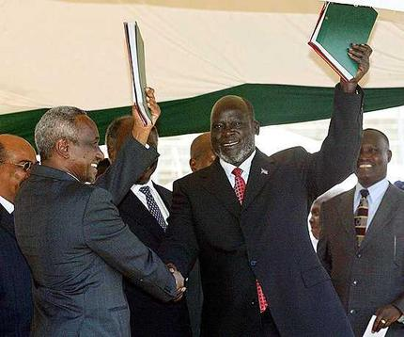
The campaign at a glance
Aim: To ensure that Sudan’s oil revenues are used to help maintain peace and prevent further conflict between North and South
Tactics: Research, policy & advocacy

Slide 19
What was required for the campaign aim to be met:
Clear and fair figures on the who, where, when and how much of oil extraction and trade
Equitable revenue sharing
Peace to be maintained

Slide 20

Campaign objectives & activities
Objectives:
Backing from key donor governments and institutions
Strong Terms of Reference for an audit drafted by a donor-backed team, and accepted by the Sudanese govt
The audit to be carried out, to include strong recommendations, and its results to be made public
4. Public backing from donors for audit recommendations to be adopted and new wealth sharing agreement to include transparency requirements
Activities:
Research & publish a briefing outlining continued discrepancies in oil figures
Extensive advocacy targeting US, Norway and UK decision makers, as well as International Finance Institutions
Notes:
These are the objectives for December 2009-May 2010 inclusive. You can see that they are incremental improvements – we hoped that later in the year / in 2011, these recommendations would in reality be adopted and that the wealth sharing agreement would include transparency requirements.
How did we hope to reach these? Through researching and publishing a briefing, and extensive advocacy targeting US, Norway and UK decision makers, as well as key stakeholders in the World Bank
Objectives:
Backing from key donor governments and institutions for a robust, transparent audit
Strong Terms of Reference for an audit drafted by a donor-backed team, and accepted by the Sudanese govt
The audit to be carried out, to include strong recommendations, and its results to be made public
4. Public backing from donors for audit recommendations to be adopted and new wealth sharing agreement to include transparency requirements
Activities:
Research & publish a briefing outlining continued discrepancies in oil figures
Extensive advocacy targeting US, Norway and UK decision makers, as well as International Finance Institutions
20

Slide 21
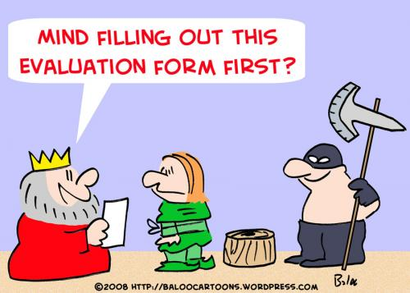
Evaluation challenges and solutions
Challenges:
Assessing and communicating contribution;
Making the process light touch;
Solutions:
Campaigner self-assessment to be scrutinised by management;
How long it took - 1-2 hours for campaigner, 1 hour for management;
What happened next - Campaigns Director reviewed alongside other campaign evaluations; overall summary assessment sent to senior management for review
Notes:
The idea of evaluation is often greeted with trepidation inside campaigning organisations, but really it is there to help you understand where you are going right, wrong and where you can improve. It’s important to show it can be light-touch, and the benefits that campaigners can reap from it are extensive – they shouldn’t feel their heads are on the block.
Nevertheless, it is important to find the system that works right for your organisation. At Global Witness we’re fortunate enough to have one person who scrutinises all the campaign self-assessments before they are passed on to the management team – the Campaigns Operations Adviser.
21

Slide 22
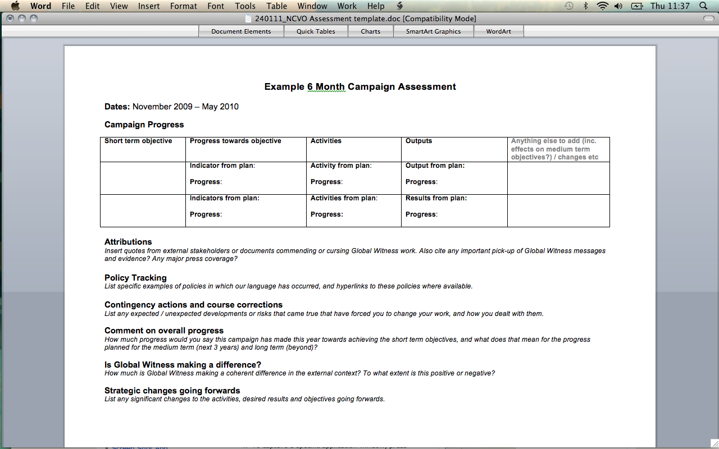
Notes:
Campaign progress
Attributions
Policy tracking
Contingency actions & course corrections
Comment on overall progress
Is Global Witness making a difference
Strategic changes going forwards
22

Slide 23

So what did we learn?

Slide 24
Objective 1 – Met
“Backing from key donor governments and institutions for a transparent audit with strong ToR.”
Activities
Research new evidence of oil discrepancies.
Lobby for language in US Appropriations legislation to force the US to act.
Outputs
Short briefing using research published.
Story covered by at least three high impact international, and three well known Sudanese media outlets.
Progress towards objective
Backing secured
Notes:
“Backing from key donor governments and institutions for a transparent audit with strong ToR.”
Activities
Research new evidence of oil discrepancies. Progress: Research carried out.
Lobby for language in US Appropriations legislation to force the US to act. Progress: Lobbying carried out
Outputs
Short briefing using research published. Progress: Research holds strong, published
Story covered by at least three high impact international, and three well known Sudanese media outlets. Progress: Covered by BBC, Bloomberg, South China Morning Post; Sudan tribune, Miraya, New Sudan Vision
Progress towards objective
Backing secured
24

Slide 25
Objective 2: Partially met
“Strong ToR drafted by donor-backed team, and accepted by the Sudanese govt”
Activities
Lobby IFIs, US government, Norway.
Lobby Sudan govt, South Sudan govt, Chinese / Malay authorities.
Outputs:
US private commitment to push Sudan govt to accept audit ToR.
Norway govt confirms that audit has been drafted.
Commitments from Sudan govt, South Sudan govt, Chinese / Malay authorities.
Progress towards objective
Text drafted, but decision now rests with Sudanese president’s office. Now behind on ambitious schedule.
Notes:
“Strong ToR drafted by donor-backed team, and accepted by the Sudanese govt”
Activities
Lobby IFIs, US government. Progress: Part completed as behind schedule
Lobby Norway. Progress: Carried out.
Lobby Sudan govt, South Sudan govt, Chinese / Malay authorities. Progress: No visa, no debate and no meetings.
Outputs:
US private commitment to push Sudan govt to accept audit ToR. Progress: Some indications of this.
Norway govt confirms that audit has been drafted. Progress: Met
Commitments from Sudan govt, South Sudan govt, Chinese / Malay authorities. Progress: No meetings & no outputs
Progress towards objective
Text drafted, but the decision now rests with the Sudanese president’s office. Now behind on ambitious schedule. BUT in April, the FCO tell our campaigner that the Norwegians think that the audit will be approved by Sudan, north and south
25

Slide 26
Objectives 3 & 4 – Not met
“The audit to be carried out. ”
“Public backing from donors for audit recommendations to be adopted and new wealth sharing agreement to include transparency requirements”
Activities
Lobby US govt, IFIs, Sudan govt.
Outputs
Commitment from donors secured to press Sudanese govt, commitment from Sudanese govt secured to carry out audit / adopt recommendations.
Progress towards both objectives
None.
Notes:
“The audit to be carried out. ”
“Public backing from donors for audit recommendations to be adopted and new wealth sharing agreement to include transparency requirements”
Activities
Lobby US govt, IFIs, Sudan govt. Progress: Not carried out due to no audit.
Outputs
Commitment from donors secured to press Sudanese govt, commitment from Sudanese govt secured to carry out audit / adopt recommendations. Progress: None due to lack of decision on audit from Sudanese govt.
Progress towards both objectives
None.
26

Slide 27
What else did we find out?
Any contingency actions or course corrections?
South Sudan’s first ever petroleum policy; satellite photography research; unable to get visas for Sudan
How was our overall progress?
Some good progress & reputation improving – helped get the audit drafted and public calls for action. Still disappointing slow rate of change however
What kind of a difference were we making?
Positive – in terms of positioning:
Raising awareness of transparency issues in Sudan
Working towards getting an audit carried out
Being poised to influence South Sudan’s first ever petroleum policy
Securing language in US appropriations act to get the govt to act on corruption issues in South Sudan
Negative:
Delays in getting visas!
Notes:
Any contingency actions or course corrections?
Asked to comment on the drafting of South Sudan’s first ever petroleum policy
Came across a satellite photography specialist and commissioned him to check out a tip off. Later publicised findings in a press release
Unable to get visas for Sudan to engage with governments and companies
How was our overall progress?
Some good progress on helping get the audit drafted and securing public calls for action.
Reputation improving.
Still disappointing slow rate of change with regards to getting an audit done before the referendum.
What kind of a difference were we making?
Positive – in terms of positioning:
Raising awareness of transparency issues in Sudan, as we have been way more effective at this than we ever hoped
Working towards getting an audit carried out
Being poised to influence South Sudan’s first ever petroleum policy
Securing language in US appropriations act to get the govt to act on corruption issues in South Sudan
Negative:
Delays in getting visas!
What we didn’t expect
Satellite specialist with Sudan and petroelum experience, asked him to check out a ti off about oil exploration we’d heard about happening in Darfur
Any strategic changes to make going forwards?
New objective: Southern Sudan enacts legislation that requires companies to publish what they pay. Confirmation by Dec 2011
New activity: Input into South Sudan petroleum policy. Drafting to start “soon” but could last as long as 9 months. Desired result: legislation requires companies to publish what they pay
27

Slide 28
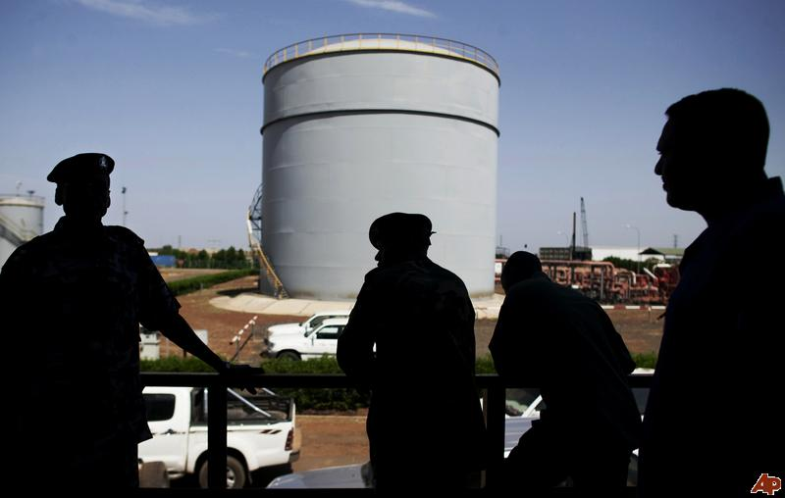
What evidence did we have for our effectiveness?
Public calls following GW lobbying:
Senior political figures in South Sudan
International Assessment and Evaluation Commission reports
UK’s Africa Minister, Glenys Kinnock
Several UK Lords
Private congratulations on our work:
Off record: Donor government
A major Sudan expert said: “Congratulations on your report! It was an amazing piece of work, and has had a larger impact than any other public report that I can think of on Sudan, and that's no small feat!”
Donor government: our Sudan campaigner was referred to as “a force of nature” on the issue of transparency in Sudan.
  Policy tracking:
  UK Associate Parliamentary Group on Sudan report namechecks our work and mirrors many of our policy calls.
  Media presence and response:
  Sudanese United government energy minister invites GW to Khartoum to inspect the oil books, in a live TV debate with our Sudan campaigner on BBC Arabic TV
Notes:
So what were the pieces of evidence that would help us make out the picture of how effective we are being?
Remember that we have been the only group calling for transparency in figures as vital to ongoing peace.
Senior political figures in South Sudan call for transparency in oil figures, e.g. "[The North] are rejecting any kind of transparency and there is a complete absence and exclusion of southern Sudan and its representatives from the management and selling of this Sudanese product" GOSS Minister
International groups: Assessment and Evaluation Commission reports talk about the wealth sharing aspects of the CPA being implemented well, implying that talk here of transparency issues was probably down to Global Witness.
UK government: UK’s Africa Minister, Glenys Kinnock, visits Sudan and calls for agreement on a fair distribution of oil revenues. We lobbied FCO staff in advance of this trip and ensured that Glenys Kinnock was briefed on Fuelling Mistrust.
Several Lords call for more transparency/need for an oil audit and reference Global Witness and/or Fuelling Mistrust.
Sudanese United government energy minister invites GW to Khartoum to inspect the oil books, in a live TV debate with our Sudan campaigner on BBC Arabic TV
28

Slide 29
So what did we know after 6 months?
Positive impact?
  Not yet. Continual monitoring necessary.
Positive outcomes?
  Yes - incremental improvements, but not as much as we had hoped
  No – delays in getting hold of visas!
Contribution to outcomes?
  Yes. Disappointed with progress but knew we had done a good job – of course our work had raised the heckles of North Sudan and prevented us from getting visas.
On schedule?
  To the greatest extent, yes, and all activities carried out
How did this help us?
  Informed tactics: US & Norway were now more responsive to our work
  Helped us show our effectiveness and secure new funding for 3 years
When would we be able to evaluate impact?
  When improvements are secured in people's lives.

Slide 30
How did this contribute towards building a learning culture?
Review of findings and process with individual Campaign Managers individually and together
Encouraging staff to gather attributions as they go along
Organisation-wide presentation to follow each round of assessments summarising where the organisation is at
End of year internal report and external annual review to explain better the timeline of activities leading to outputs, outcomes and chances of impact

Slide 31
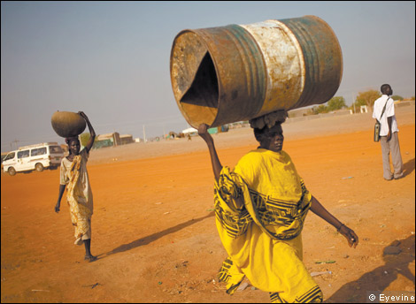
What should I take away from this?
Gather attributions as you campaign
Keep evaluation light-touch
Try to ensure someone neutral checks your evaluation
Build a picture of the consequences of your work

Slide 32
Questions and discussion
Questions to think about:
What information do you have which could help with M & E?
What information does your team or organisation possess?
What information is available from other sources that you can you tap into to help with your M & E?
Notes:
Monitoring and evaluating your campaign is not and easy process. It can be time consuming and you may feel that you do not have the resources to carry out this process. To make this process more straightforward consider the information you can tap into which could help simplify this process.

Slide 33
What can you do next?
If you have 30 minutes:
Download and read Part 1 of Is your campaign making a difference? from our website
Apply the basic evaluation framework to your campaign
If you have longer:
Purchase the complete publication for how to conduct more in depth m&e
Read The Good Guide to Campaigning and Influencing
Carry on the discussion at www.forumforchange.org.uk

Slide 34
Contact us:
Contact NCVO’s Campaigning Effectiveness Programme for bespoke advice and support
www.ncvo-vol.org.uk/campaigningeffectiveness
Campaigning@ncvo-vol.org.uk

